Slide 1


Your Policy. Applied Correctly.
ARCS is an AI governance software platform that integrates into your current AI system to implement policy in live workflows, using an English like rule format so stakeholders can review policy more easily and help keep it correct and up to date.
An AI governance software platform for helping organisations make sure policy is applied correctly in live AI systems

Slide 2
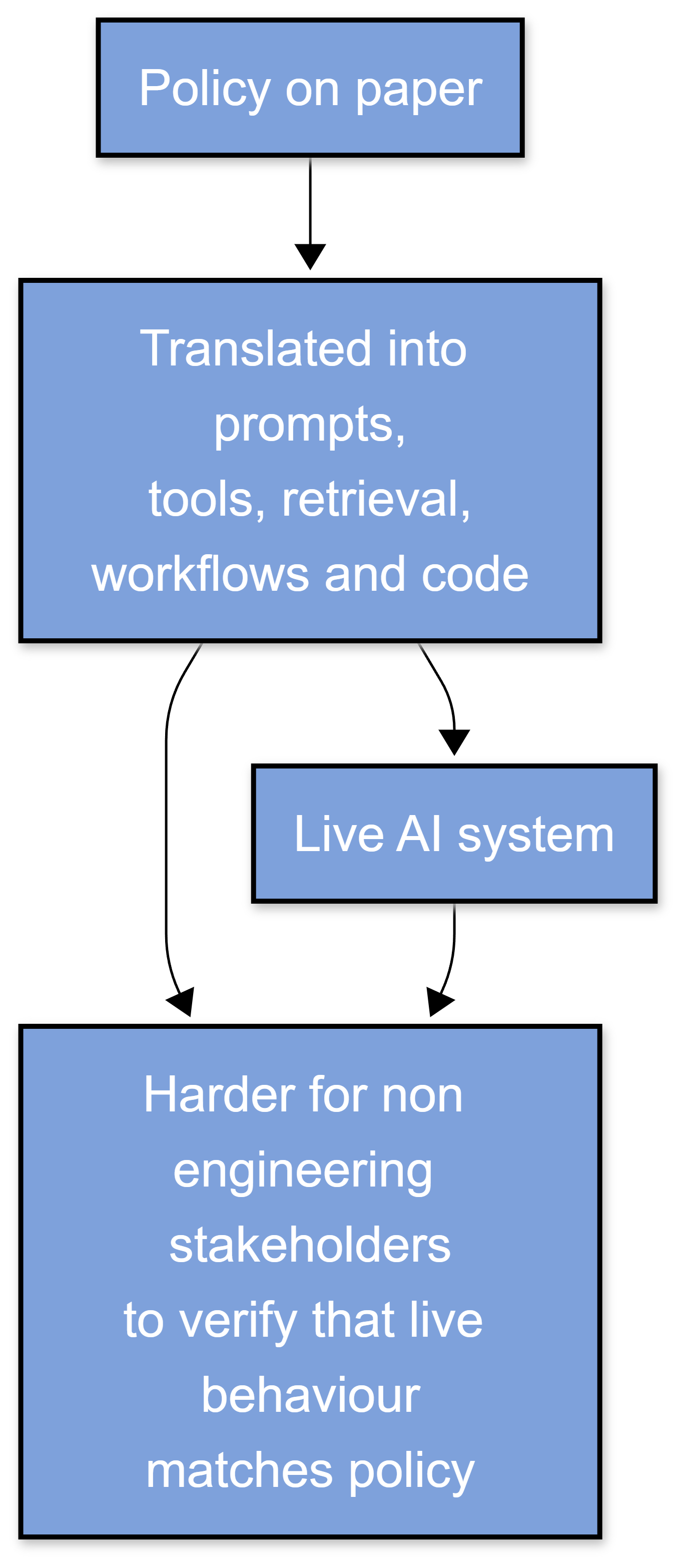
The problem
Policy may be clear on paper.
But once an AI system is live, that policy gets translated into prompts, tools, retrieval, workflow logic and code.
At that point, it becomes harder for non engineering stakeholders to see whether the running system is actually doing what the policy requires.
ARCS is built to close that gap.

Slide 3
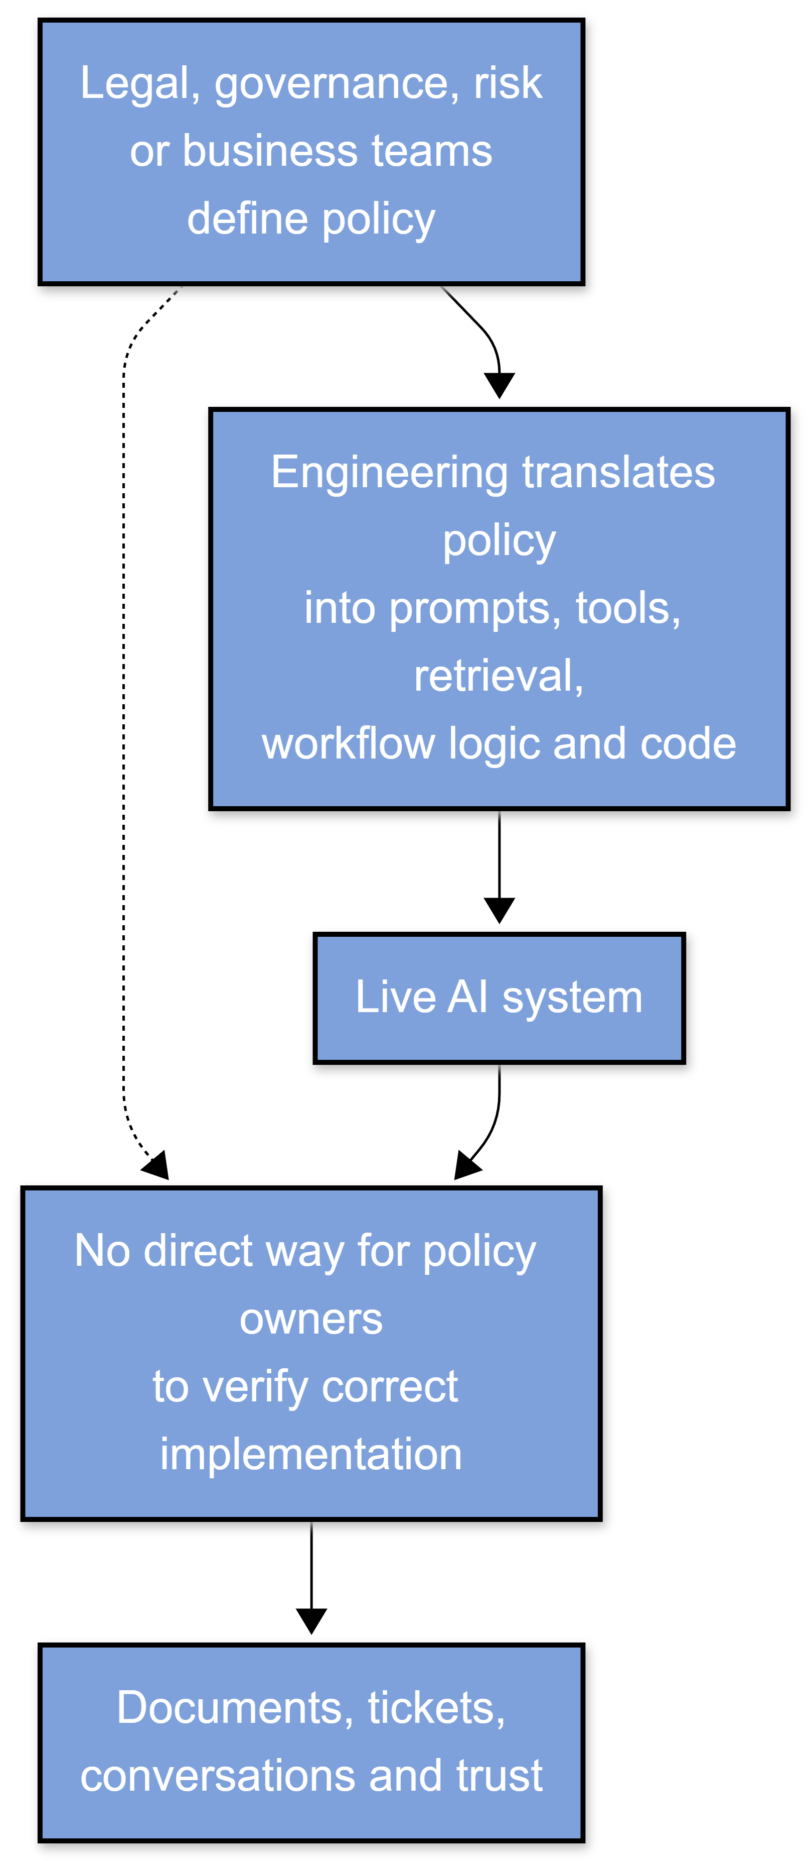
The core problem
Policy is often defined by one group and implemented by another.
Legal, governance, risk or business teams may define the policy. Engineering then translates that policy into prompts, tools, retrieval, workflow logic and code.
At that point, the people responsible for the policy often have no direct way to verify whether it was implemented correctly in the live system.
They have to rely on documents, tickets, conversations and trust.
So the main problem is not just whether policy exists. It is whether the live system is actually applying that policy correctly.

Slide 4
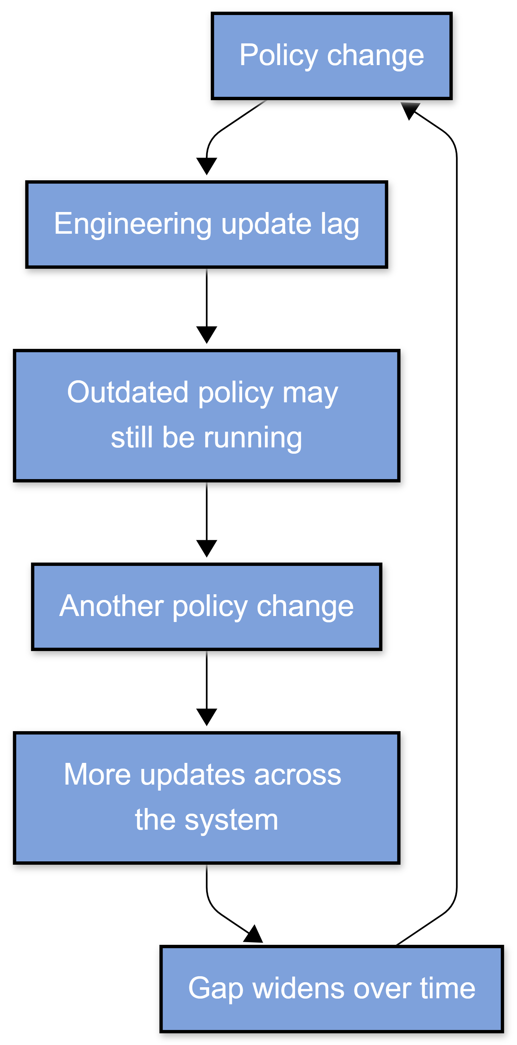
Why this gets worse over time
The implementation process is usually static.
A new policy or policy change arrives. Engineering has to interpret it and update the system in different places.
Until that work is done, the live system may still be running outdated policy.
And even after the update is made, the people responsible for the policy still may not have a clear way to confirm that it is now correct across the running system.
Policy does not change only once. It changes again and again.
So the gap widens over time as policy changes, systems evolve and more implementation logic builds up across the live environment.

Slide 5
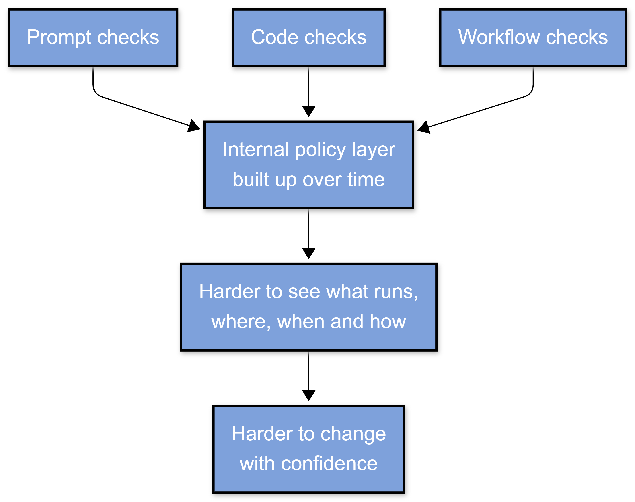
What teams often do today
Many teams build this themselves.
They add checks into prompts, code and workflow logic. Over time, that becomes an internal policy layer.
That can work for a while. But it creates a more static model.
Policy is spread across the system
Harder to see what is currently running
Harder to see where it runs
Harder to see when it activates
Harder to see how it is applied
Harder to change with confidence

Slide 6
What ARCS provides
What policy is running
Where policy runs
When rules activate
How policy is applied
Defined explicitly in the binding section of the rule
Defined explicitly in the binding section of the rule through the chosen activation strategy
Defined explicitly in the binding section of the rule through the chosen execution pattern
Readable policy in a customised English like language
What result should follow
Defined explicitly in the policy section through outcome, reason, audit, and handle_with. For example allow, block, modify, escalate, require human review, alert or terminate
ARCS gives teams a structured way to make policy visible and manageable through rules, without policy disappearing into scattered implementation logic.

Slide 7
Example policy: Block high risk external transfers outside working hours when no manager approval exists
Example rule
RULE block_high_risk_external_transfer_after_hours
POLICY
DESCRIPTION Block high risk external transfers outside working hours when no manager approval exists
IF context.customer_risk == "high“ AND context.destination == "external"
AND context.after_hours == true AND context.manager_approval == false
THEN OUTCOME block
WITH reason "High risk external transfer outside working hours requires manager approval"
WITH audit "Blocked high risk external transfer outside working hours without manager approval"
WITH handle_with "payments.transfer.block_and_alert"
BINDINGS
BINDING
BOUNDARY tool.call
TARGET payments.agent.transfer_funds
STAGE pre
ACTIVATION
STRATEGY context_combination
INPUT context.customer_risk, context.destination, context.after_hours, context.manager_approval
MATCH combined_condition
END ACTIVATION
EXECUTION_PATTERN explicit_direct_boundary_call
END BINDING
END RULE
What
Shown in the policy section so stakeholders can see the active rule
Where
Shown in the binding as tool.call targeting payments.agent.transfer_funds at pre stage
When
Shown in the binding through the chosen activation strategy, here context_combination across context.customer_risk, context.destination, context.after_hours, and context.manager_approval
How
Shown in the binding through the chosen execution pattern, here explicit_direct_boundary_call
Result
The rule returns outcome block, with a reason, an audit record, and the handler payments.transfer.block_and_alert
How one policy is managed in ARCS
ARCS does not only show policy.
It gives teams a structured way to manage how that policy is applied in the live system.
The policy can be shown in readable English like form, so stakeholders can see what is active.
The binding section is then used to define
where the policy runs, including boundary, target, and stage,
when it activates through the chosen activation strategy,
and how it is applied through the chosen execution pattern
That is what makes policy visible, manageable and correctly applied, while still keeping the policy itself readable.

Slide 8
What you get with ARCS Version 1
ARCS Version 1 is the current working implementation of ARCS, with the first core pieces in place for writing policy, loading it into the runtime and applying it in live workflows.
ARCS DSL VS Code extension Rules are written in the ARCS DSL Visual Studio Code extension in a customisable English like format, so policy can be expressed in a form that stakeholders can understand and review more easily.
JSON compiler Rules are compiled into JSON and prepared for runtime use, so what is written in the rule format becomes something the live system can load and apply.
Python based runtime Rules are loaded into a Python based runtime that evaluates policy during live system operation. The same model can be extended to other languages through thin wrappers around the runtime.
Live boundary integration Your application calls ARCS from the point where a policy decision is needed, passing context from the real workflow so the rule is checked against the live situation.
Structured result and next action ARCS returns a result such as allow, block, modify, escalate, alert, terminate or require human review, together with the reason, audit information and the next handler or function to call.
Local policy operations dashboard Rules can be viewed through a React based dashboard running on the local intranet, so policy and governance stakeholders can see what is active, review rules more easily, and inspect how policy is being applied without relying only on developer tooling.
Decision testing and runtime visibility The dashboard can be used to view loaded rules, run policy checks with example or live context, inspect returned results, and review decision evidence so teams can understand how ARCS is behaving in practice.
Get a focused partner for policy implementation Work with a partner focused on improving ARCS tooling over time, so you can benefit from the latest approach for helping keep policy correct and up to date in live AI systems.

Slide 9
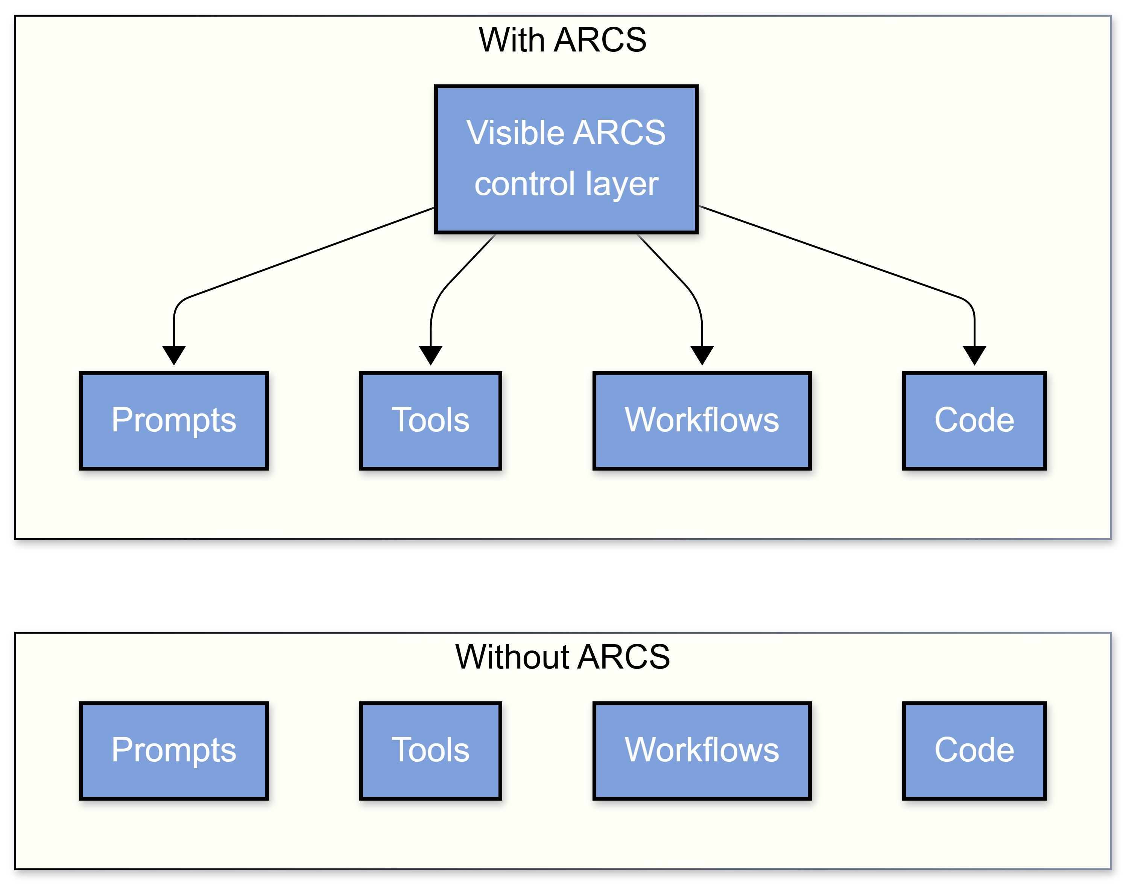
Why ARCS is different
ARCS is built around a different idea.
Recommended diagram
Policy should be treated as a visible system control, not something hidden piece by piece inside prompts, tools, workflows and code.
Scattered implementation
vs
visible ARCS control layer
Policy becomes visible as an active state, not just documentation
Policy becomes easier to review across stakeholders
Policy becomes easier to update with confidence
Policy becomes easier to apply correctly across the live system
Policy becomes less dependent on ad hoc internal logic
ARCS is a dedicated implementation platform for correct policy application.

Slide 10
A structured control foundation
What policy is currently running
When should a rule activate
Currently 1o structured activation strategies made explicit in rule bindings.
For example only for certain users, only in higher risk flows, only when sensitive data is involved, or only when a particular tool is about to be used
Readable policy in a customised English like language. Lets stakeholders see and review the active policy without searching through prompts, tools, workflows or code
Where should policy run
How should policy be applied
Currently 26 execution points made explicit in rule bindings
For example before a model call, after a model response, before a tool call, after retrieval, or around a workflow transition
Currently 7 execution patterns made explicit in rule bindings
For example framework interception points, direct boundary calls, runtime instrumentation, network proxy enforcement, MCP aware supervision, or capability mediation
What result should follow
Each rule returns a structured result with an outcome, a reason, an audit record, and a handler
Current outcomes include allow, block, modify, escalate, require human review, alert, and terminate

Slide 11
What already exists in the market
AI governance platforms and GRC tools
Gateways and proxies
Strong on inventories, approvals, evidence and reporting
Strong on provider level traffic, routing and logging
Observability tools
Policy engines and business rules tools
Strong on showing what happened and helping debug behaviour
Strong on evaluating rules outside application code
Guardrails and AI security tools
Workflow tools
Strong on checking prompts, outputs and attacks, often at narrower boundaries
Strong on orchestrating multi step execution
These categories are useful. But they still leave teams with the harder problem of making sure policy is applied correctly across a live AI system.
For detailed market analysis and positioning of ARCS please refer to ARCS_comparative_analysis.pptx

Slide 12
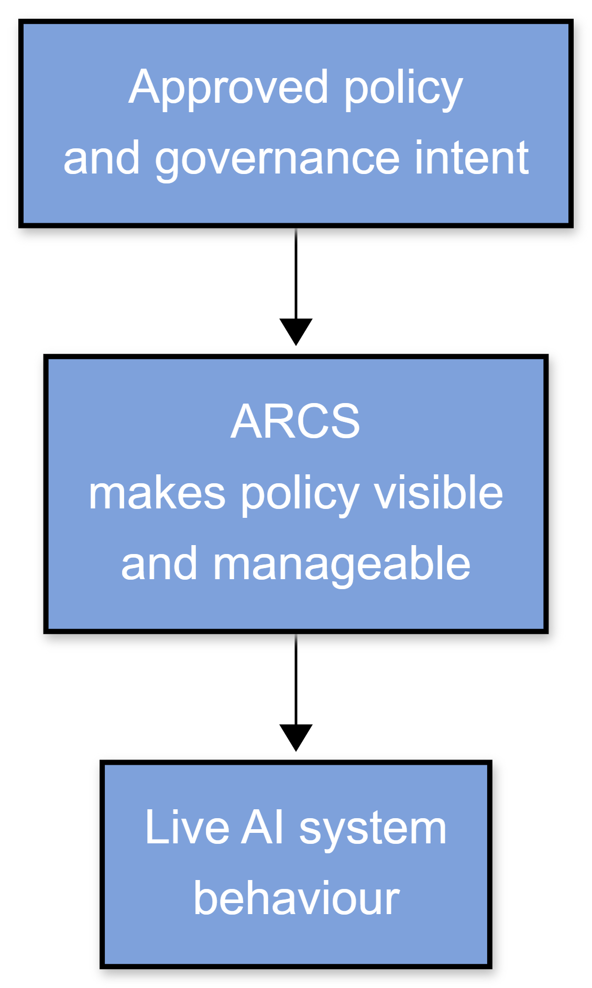
Where ARCS fits
ARCS sits between governance intent and live AI behaviour.
It is not mainly:
a governance dashboard
an observability tool
a model gateway
a guardrails library
a generic rules engine
It is the implementation platform that makes approved policy visible and manageable as a live system control.

Slide 13
Why not keep this entirely in house
Organizations may ask ….
Why not just build this ourselves?
You still keep ownership of the policy. What ARCS adds is a specialised implementation platform and specialist capability built around this exact problem.
Your team stays focused on the core system and business logic.
ARCS keeps improving the policy language, the rule model, the control coverage, the execution patterns and the outcome model.
This gives teams the benefit of specialisation without giving up control.

Slide 14
Why ARCS is credible
ARCS comes from real experience with the kinds of problems it is trying to solve.
deep experience in complex enterprise systems
research in aspect oriented approaches
large scale rule design in production environments
experience creating vocabulary for executable rules
hands on work in high volume transaction systems
This includes work across IBM, Mastercard, Boeing and Intel.
At Mastercard, this included writing rules and helping shape rule vocabulary in very high volume transaction environments.
ARCS comes from real systems, real rules and real control problems.

Slide 15
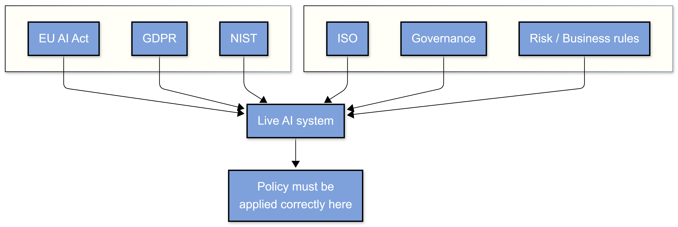
Why this matters now
More AI in production.
More policy to apply.
EU AI Act. GDPR. NIST. ISO.
Internal governance. Risk controls. Business rules.
All of it still has to be applied correctly in the live system.
When something goes wrong, accountability stays with the organisation.
Your Policy. Applied Correctly.

Slide 16
What we are looking for
Design partners who feel the pain of policy being hard to verify in live AI systems
Pilot opportunities where policy needs to be visible, reviewable and applied correctly across live workflows
Introductions to AI leaders, governance leaders and partners working close to this problem
Conversations with investors and strategic partners who understand the need for a stronger implementation layer between policy intent and live AI behaviour
If this problem is familiar, I’d value a conversation.
Contact
Yaseen
yaseen@arcsruntime.com
arcsruntime.com
LinkedIn: https://www.linkedin.com/in/yaseen-ali-8a78214/

