Slide 1

How this deck should be read
This deck is the comparative analysis companion to the main ARCS deck.
For the wider product context, problem, architecture, and implementation direction, please refer to the main ARCS presentation deck, ARCS_deck.pptx.
how ARCS is differentiated in the current market
what adjacent product categories already exist
which named products sit near the problem ARCS addresses
This deck covers
Notes:
[Sources]
Main companion deck: ARCS_deck.pptx

Slide 2
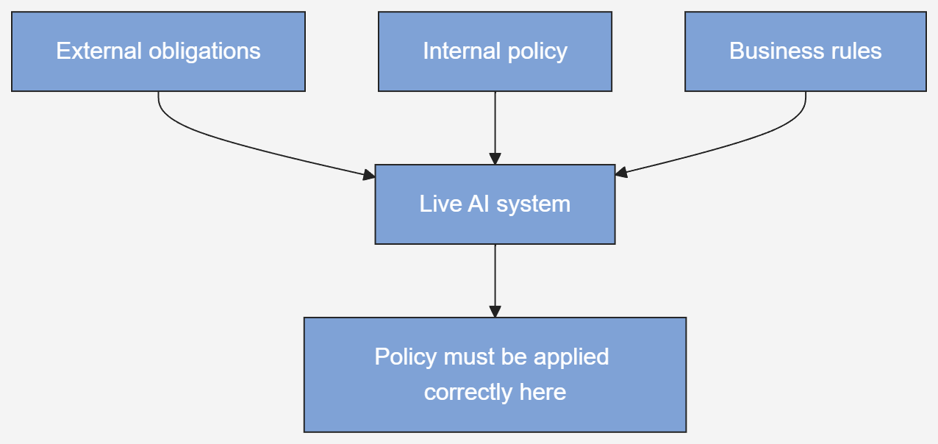
ARCS is focused on helping organisations apply policy correctly in live AI systems
Many organisations already have policies, governance frameworks, and control processes for AI.
The harder problem starts when that policy has to be implemented correctly in a live system across prompts, tools, retrieval, workflows, permissions, and code.
ARCS is focused on helping organisations keep that policy correct and up to date in live operation by making it more visible, reviewable, and manageable across technical and non technical stakeholders.
Notes:
[Sources]
Main companion deck: ARCS_deck.pptx
Positioning and market research files uploaded by user

Slide 3
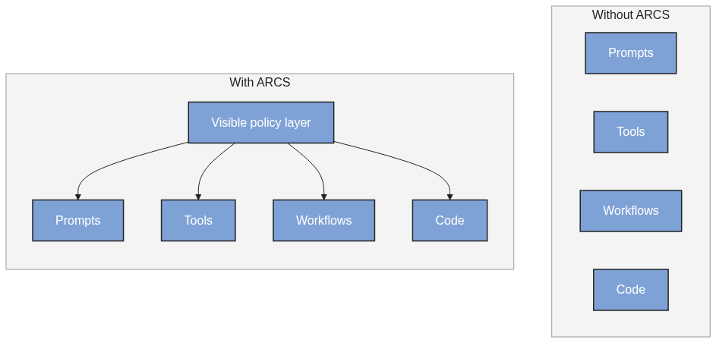
How ARCS is different
The main differentiation is that ARCS is built around correctness of policy application.
the active policy is visible in a readable form
technical and non technical stakeholders can review the same policy surface
policy is not buried only in prompts and scattered code
policy is connected to live execution points where AI systems decide and act
A policy applied incorrectly is a policy not applied.
Notes:
[Sources]
Main companion deck: ARCS_deck.pptx
Positioning and market research files uploaded by user

Slide 4
What exists in the market today
AI governance platforms and GRC tools
Gateways and proxies
Strong on inventories, approvals, evidence and reporting
Strong on provider level traffic, routing and logging
Observability tools
Policy engines and business rules tools
Strong on showing what happened and helping debug behaviour
Strong on evaluating rules outside application code
Guardrails and AI security tools
Workflow tools
Strong on checking prompts, outputs and attacks, often at narrower boundaries
Strong on orchestrating multi step execution
These categories are useful, but they are usually not centred on helping mixed stakeholder groups keep live AI policy correct through a readable policy surface.
Notes:
[Sources]
Comparative analysis research files uploaded by user

Slide 5
Comparative examples from the market
Holistic AI, Credo AI
Arize, LangSmith
Lakera, Protect AI
Kong AI Gateway
OPA, Styra, Oso, Cerbos
Strong at governance workflows, risk management, compliance mapping, and oversight. Not primarily positioned around readable policy as the control surface for live AI execution.
Strong at traces, debugging, evaluation, and understanding what happened in production. Not primarily focused on making policy readable and executable as the source of live control.
Strong at prompt security, output safety, and runtime threat detection. Not focused on shared policy authoring between policy stakeholders and engineering.
Strong at centralising model access, logging, routing, and provider controls. Does not usually provide a broader readable policy layer for prompts, tools, workflows, and downstream execution.
Strong at deterministic rule evaluation and externalised policy logic. Mainly focused on infrastructure policy, authorisation, or general policy as code.
What this comparison shows
These products are strong in their own areas, but they are mainly focused on governance workflow, observability, security, gateway control, or technical policy evaluation. ARCS is different because it is built around correctness of policy application in live AI systems through a readable English like policy layer that technical and non technical stakeholders can review together.
Notes:
[Sources]
Comparative analysis research files uploaded by user

Slide 6
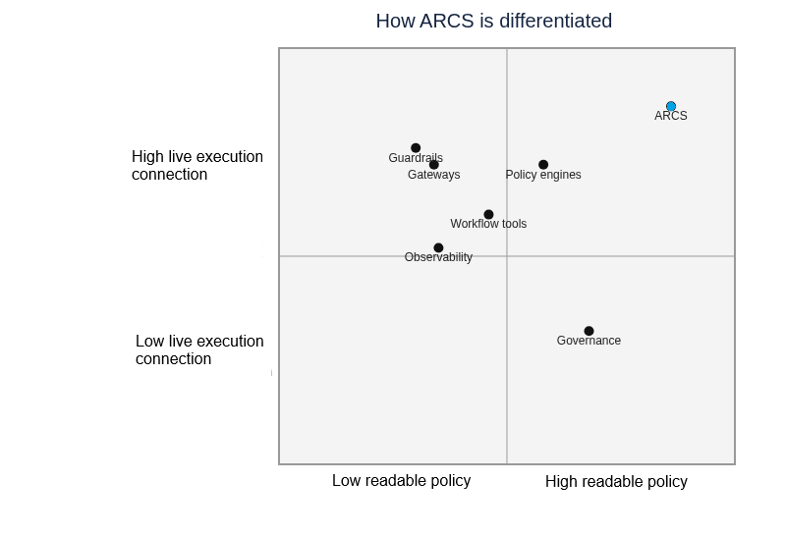
Where ARCS fits
ARCS is focused on helping organisations apply policy correctly by giving technical and non technical stakeholders a shared, readable policy surface connected to live AI execution.
readable English like policy
shared visibility across stakeholders
less dependence on scattered implementation logic
connection to live execution points where AI systems decide and act
Focus on applying correctly
That is the gap ARCS is focused on in the current market.
Notes:
[Sources]
Main companion deck: ARCS_deck.pptx
Positioning and market research files uploaded by user

